Slide 1
Spreadsheet Does What?
James Abel
www.abel.co
https://github.com/jamesabel/spreadsheetdoeswhat
An homage to https://www.pythondoeswhat.com

Slide 2
CSV/Spreadsheets are the Worlds Database
Me:
Please give me access the data in your database
Them (email):
Of course! Please see the attached CSV file!
Party on! \m/

Slide 3

Survey
I
Spreadsheets
?

Slide 4

Survey
I
Spreadsheets
?

Slide 5


Slide 6
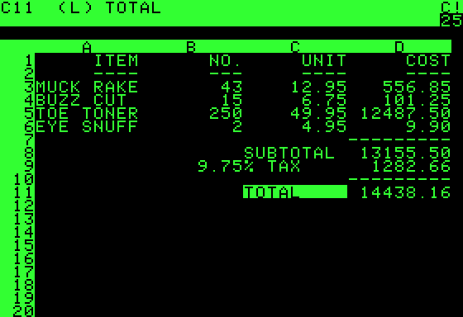
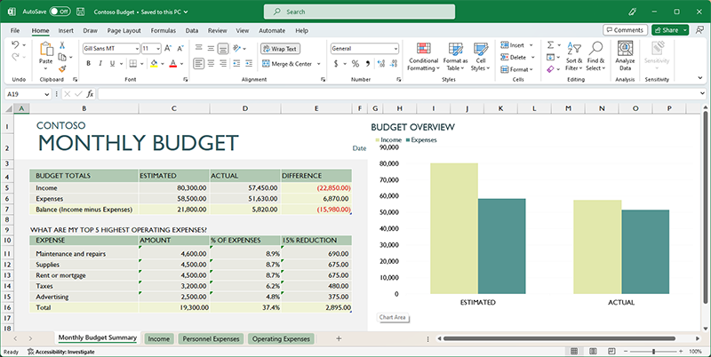
A Little History
CSVs - 1972
VisiCalc (Apple II) - 1979
Excel - Mac 1985, Windows 1987
Python support - 2023
CSV RFC 4180 - 2005
VisiCalc
Excel

Slide 7
Python and Spreadsheet/Excel
Python csv module (built-in)
Packages include:
openpyxl
Pandas (openpyxl default engine)
xlrd

Slide 8
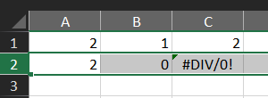
Tales From The Field or Do I Really Need to Validate My Data?
wb = open_workbook('totally_normal_spreadsheet.xls')
ws = wb.sheet_by_index(0)
print("xlrd:")
for column in (0, 1, 2):
value = ws.cell(1, column).value
print(value, type(value))
xlrd:
2.0 <class 'float'>
0.0 <class 'float'>
7 <class 'int'>
openpyxl:
2 <class 'int'>
0 <class 'int'>
#DIV/0! <class 'str'>

Slide 9
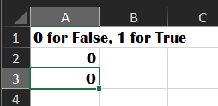
Tales From The Field
wb = load_workbook('o_no.xlsx', data_only=True)
ws = wb.active
a = ws["A2"].value
b = ws["A3"].value
a_bool = bool(a)
b_bool = bool(b)
print("openpyxl")
print("a", a, type(a), a_bool)
print("b", b, type(b), b_bool)
openpyxl
a 0 <class 'int'> False
b O <class 'str'> True
A2 is a number (proper)
A3 is a string (improper)

Slide 10
tobool to deal with Python’s truthiness
pip install tobool
from tobool import to_bool
bool(False)
False
bool("False")
True
to_bool("False")
False
(not only a CSV/Spreadsheet issue)
https://github.com/jamesabel/tobool

Slide 11
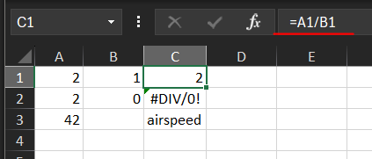
Another example
import pandas as pd
df = pd.read_excel('pandas_example.xlsx')
print(df)
2 1 2.1
0 2 0.0 NaN
1 42 NaN airspeed
should be read_excel(…, header=None)

Slide 12


Summary
Always check data formats and types
Example: pydantic
Always sanity check answers
Always check calculations done in spreadsheets
Always check for irregular values such as NaNs
Be careful when choosing default ‘NA’s and associated filters
Gorge of Eternal Peril
spreadsheet

